Slide 1
Hospitality Analysis
By Group 4
JAYPALJI CHAUHAN
AKASH BORSE
SUNKARA SAI SURYA GANESH
ASHMITHA N RAJ

Slide 2
Tools Used :
Excel
SQL
Tableau
Power bi
– JAYPALJI CHAUHAN

Slide 3
Overview
Hospitality Analysis uses data to improve customer experience, optimize operations, and boost revenue in sectors like hotels and travel.
Key metrics include: ADR (Average Daily Rate), Occupancy Rate, RevPAR (Revenue per Available Room), and customer satisfaction scores.
Techniques like trend analysis, customer segmentation, and predictive analytics help track performance, forecast demand, and personalize services for better decision-making.
– JAYPALJI CHAUHAN

Slide 4
Project Workflow:
1. Extract Data/Import Files
2. Transform Data (Remove Blank And Duplicates)
3. Manage Relationships
4. KPI And Visualization
5. Dashboard
– JAYPALJI CHAUHAN

Slide 5
KPI’s
Total Revenue
Occupancy
Cancellation Rate
Total Booking
Utilize capacity
Trend Analysis
Weekday & Weekend Revenue and Booking
Revenue by State & hotel
Class Wise Revenue
Checked out cancel No show
Weekly trend Key trend (Revenue, Total booking, Occupancy)
– JAYPALJI CHAUHAN

Slide 6
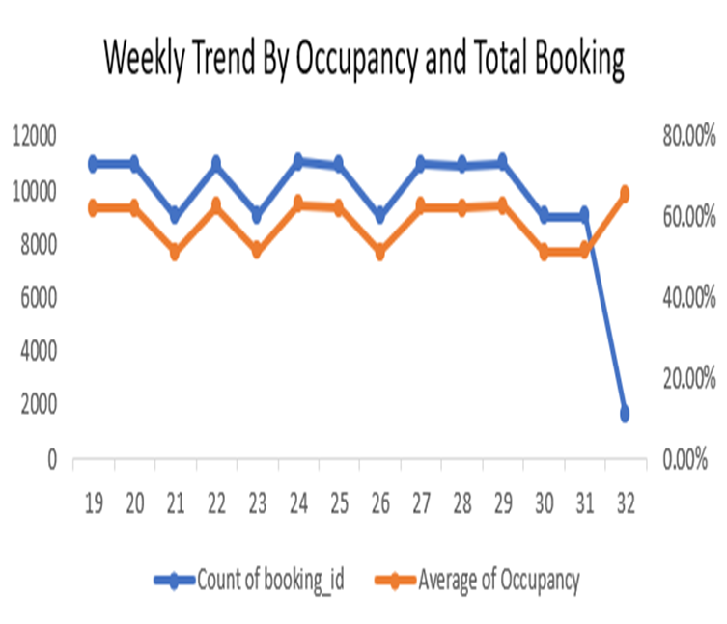
Weekly Trend Analysis
Overview of Trends Total Bookings: Week 19 saw the highest bookings at 11,095.
A gradual decline observed with minor fluctuations through weeks 23 to 30, with a low point of 1,651 bookings in week 32.
Average Occupancy Rate: Fluctuated between 51.31% to 65.66% across various weeks.
Peak occupancy reached in week 29 at 65.66%, indicating better utilization during that period.
A notable drop in average occupancy is observed during week 32, aligning with the decrease in total bookings.
– AKASH BORSE

Slide 7
Weekly Trend Analysis
Key Insights:
There is a correlation between total bookings and occupancy rates, indicating that as bookings decline, so does occupancy.
Week 32 shows a significant drop in both metrics, suggesting potential issues that need addressing, such as market demand or booking strategies.
Conclusion Overall trends suggest the need for strategic improvements in marketing and operations to boost both booking counts and occupancy rates, especially in weaker weeks like week 32.
– AKASH BORSE

Slide 8
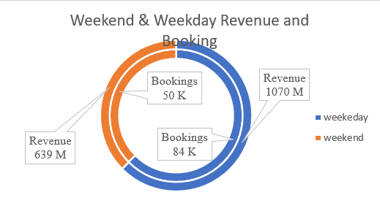
Weekday & Weekend Revenue and Booking
Weekday Performance:
Revenue: 639M, Bookings: 50K
Lower demand during weekdays
Weekend Performance:
Revenue: 1070M, Bookings: 84K
Higher demand and revenue on weekends
Insight :
Focus on promotions to boost weekday bookings.
– AKASH BORSE

Slide 9
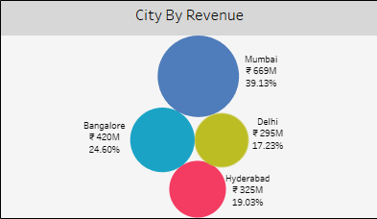
Revenue by city
Mumbai: Leading city with total revenue of ₹669M with 39% of total revenue.
Bangalore: Second-highest revenue at ₹420M with the share of 25% of total revenue.
Hyderabad: Generates ₹325M with 19% of total revenue.
Delhi: Lowest among the listed cities with ₹295M and 17% of total revenue.
– SUNKARA SAI SURYA GANESH

Slide 10
Revenue by city
Key Points :
Mumbai dominates the revenue landscape.
Bangalore, Hyderabad, and Delhi follow, but with significant gaps in revenue compared to Mumbai.
Conclusion : Mumbai is a clear leader in revenue generation, indicating its strong economic position.
Other cities show potential but need strategies to enhance their revenues.
– SUNKARA SAI SURYA GANESH

Slide 11
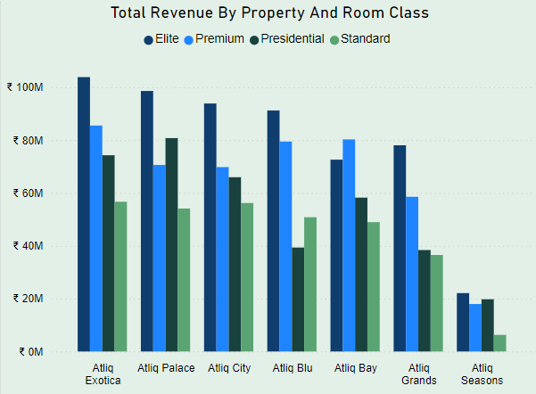
Class Wise Revenue
Total Revenue by Property and Room Class Overview of Revenue Generation :
Atliq Exotica: Leading with a total revenue of ₹104M, driven by strong performance in all room classes, especially Elite.
Atliq Palace: Close second with ₹99M, significant contributions from both Presidential and Elite categories.
Atliq City: Revenue stands at ₹94M, with solid performance across all room classes.
Atliq Blu: Achieved ₹91M in revenue, notably strong in the Premium category.
– SUNKARA SAI SURYA GANESH

Slide 12
Class Wise Revenue
Atliq Bay: Generated ₹80M, with more demand for Premium compare to Elite rooms.
Atliq Grands: Total revenue of ₹38M, struggling in Standard categories.
Atliq Seasons: Lowest at ₹22M, indicating a need for strategic improvement.
Conclusion :
The Elite Room Class is the strongest revenue driver across the properties.
Atliq Exotica and Atliq Palace stand out as top performers.
Atliq Seasons shows potential for growth, requiring targeted strategies for improvement in revenue generation.
– SUNKARA SAI SURYA GANESH

Slide 13
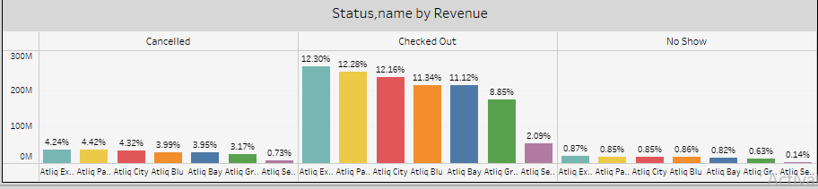
Checked out, cancel, No show
Revenue Status Analysis Overview
Cancelled Reservations:
Atliq Palace: Highest cancellation rate at 4.42%.
Atliq City: Close behind at 4.32%.
Other properties show lower cancellation rates, with Atliq Seasons at 0.73% being the lowest.
Checked Out:
Atliq Exotica leads with 12.30% of revenue from checkouts.
Atliq Palace and Atliq City follow closely, showcasing a strong overall performance.
Atliq Seasons lags at 2.09%, indicating lower revenue generation from checked-out guests.

Slide 14
Checked out cancel No show
No Shows:
Atliq Exotica: Slightly better performance at 0.87%.
Majority of properties have low no-show rates, with Atliq Seasons at 0.14%, reflecting minimal impact from guests not arriving.
Conclusion:
Atliq Exotica and Atliq Palace show high revenue from cancelled and checked-out reservations, indicating strong demand.
Atliq Seasons presents challenges, particularly in cancellation and checked-out revenues, warranting strategic attention to enhance guest arrivals and bookings.

Slide 15
More Findings
Total Revenue – 1709M
Occupancy – 58%
Cancellation Rate – 25%
Total Booking – 134.59K
Utilize capacity – 70%
– ASHMITHA N RAJ

Slide 16
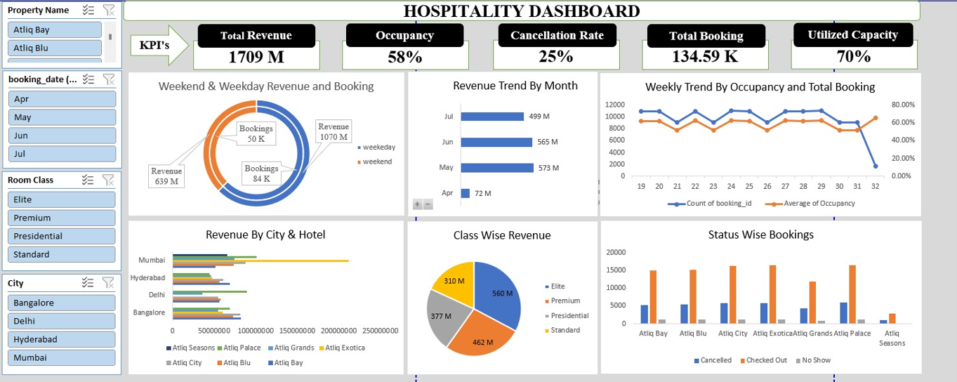
EXCEL DASHBOARD
– ASHMITHA N RAJ

Slide 17
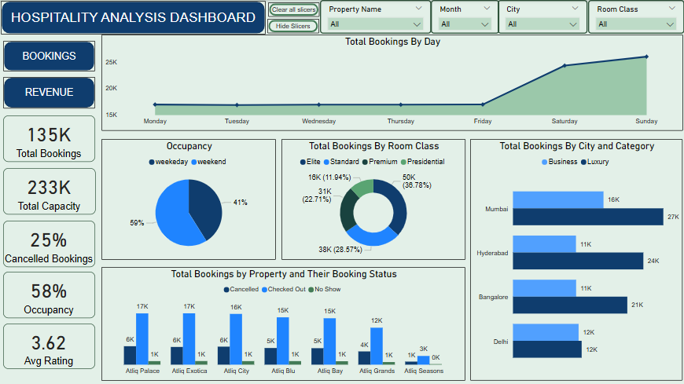
POWER BI DASHBOARD
– ASHMITHA N RAJ

Slide 18
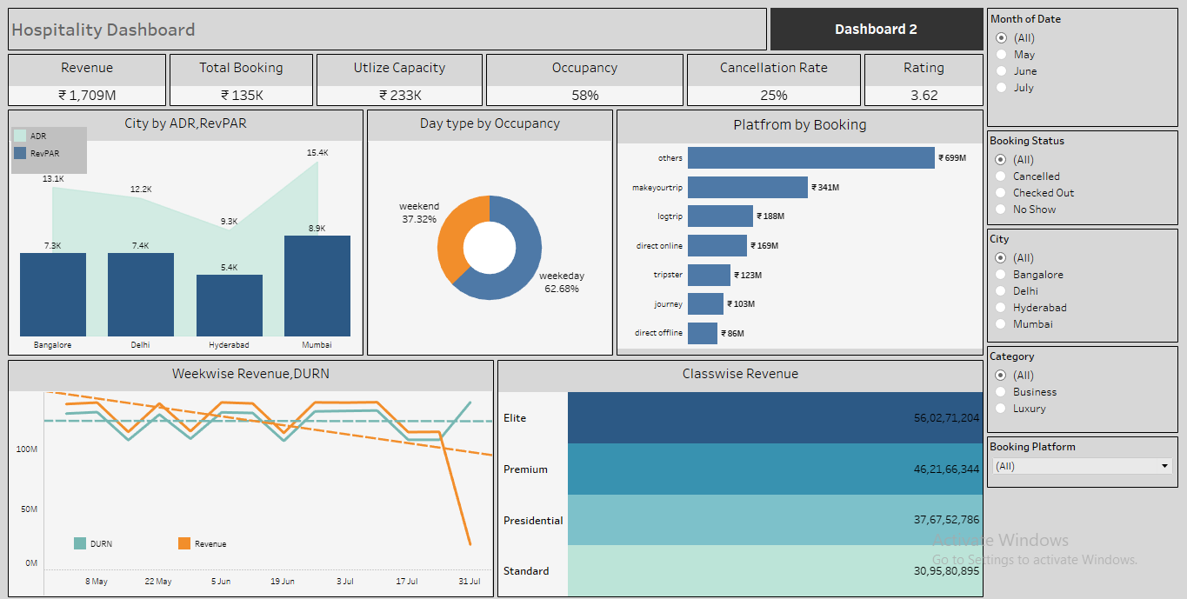
TABLEAU DASHBOARD

Slide 19
THANK
YOU

